Slide 1

Instacart Market Basket Analysis
What is Instacart ?
Instacart is a popular grocery delivery service that acts as a bridge between customers and stores. Imagine it as a giant online marketplace specifically for groceries. Customers browse a vast selection of stores near them using the Instacart app or website. They can fill their virtual cart with everything they need, from pantry staples and household goods to fresh produce and meats. Once an order is placed, Instacart connects the customer with a personal shopper to pick, pack, and deliver their groceries – often within a couple of hours.

Slide 2
Capstone Project: Instacart Market Basket Analysis
Project Overview
This capstone project focuses on conducting an extensive data analysis of Instacart grocery ordering data. The main objective for Business Analysts is to provide comprehensive insights into customer behavior, product popularity, order patterns, and departmental performance through interactive visualizations using tools like Power BI or Tableau. Business Analysts will create dashboards that offer a 360-degree view of the business, aiding in strategic decision-making and identifying opportunities for growth and improvement.
Objectives
* Understand Customer Behavior: Analyze ordering patterns to identify customer preferences and frequency of reorders.
* Product Analysis: Determine which products are most popular, frequently reordered, and identify trends in product sales across different departments and aisles.
* Order Analysis: Examine the distribution of orders by time of day, day of the week, and interval between orders to understand peak times and purchasing habits.

Slide 3
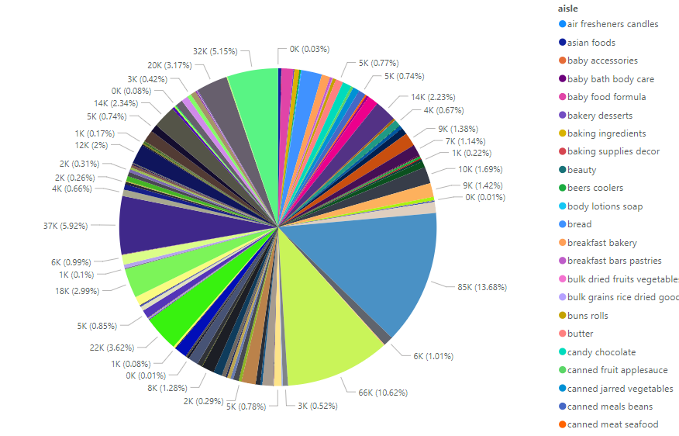
Pie chart - Sum of re-ordered By aisle
I am trying to make a pie chart. Provide detailed descriptions of the visualizations and their business relevance Exploratory Data Analysis.
The story of pie chart is sum of people re-order by aisle category.

Slide 4
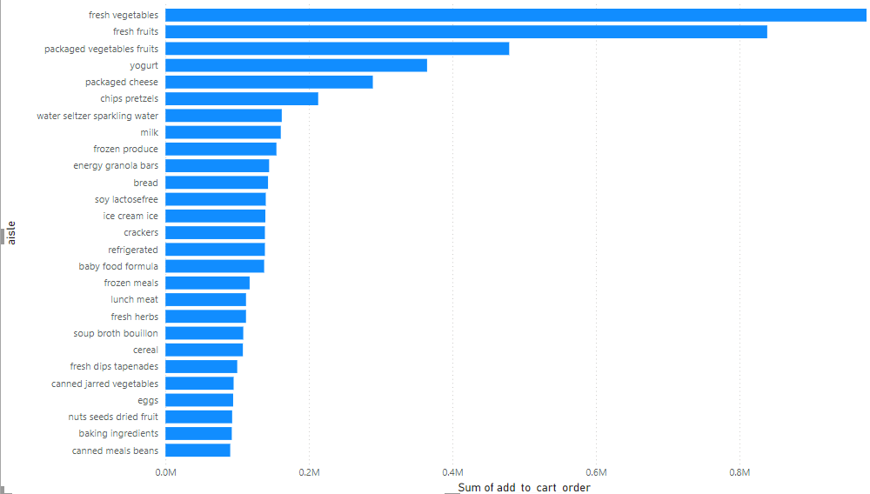
Stacked bar chart – sum of online cart order by aisle
I am trying to make a stacked bar chart. Provide detailed descriptions of the visualizations and their business relevance Exploratory.
* The story of stacked bar chart is sum of online cart order by aisle category.

Slide 5
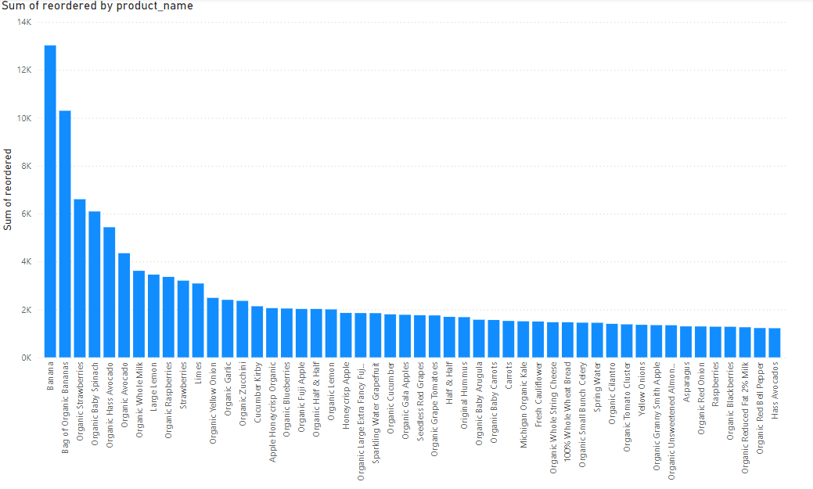
Clustered column chart – sum of re-order by Product name
* I am trying to make a Clustered column chart. Provide detailed descriptions of the visualizations and their business relevance Exploratory Data Analysis.
The story of Clustered column chart is sum of people re-order by Product name.

Slide 6
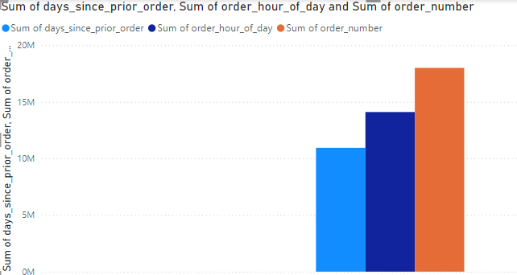
LineClustered column chart – sum of Order by sum of day & hours
* I am trying to make a Line Clustered column chart. Provide detailed descriptions of the visualizations and their business relevance Exploratory Data Analysis.
* The story of Clustered column chart is sum of order by sum of day & hours.

Slide 7


